Slide 1

Metadata Madness: Lessons from ENCODE
Cheryl A. Keller
Penn State University
July 10, 2017

Slide 2
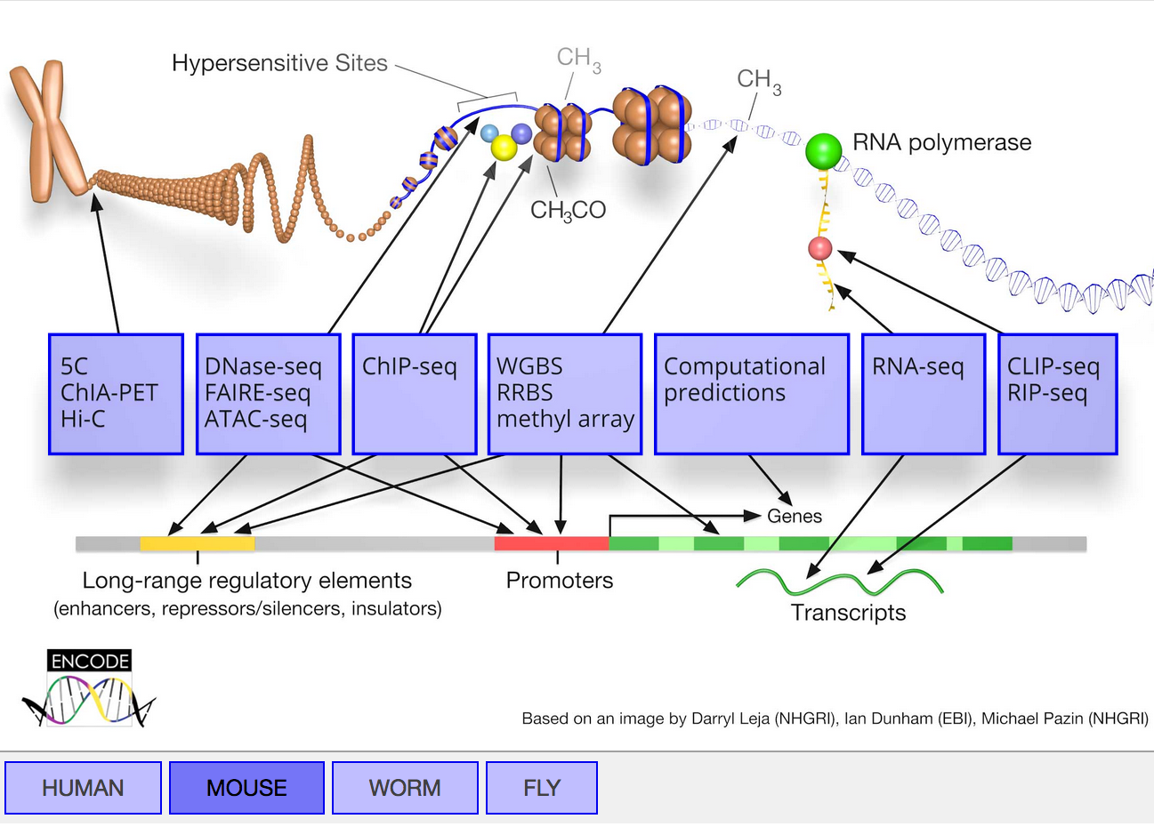
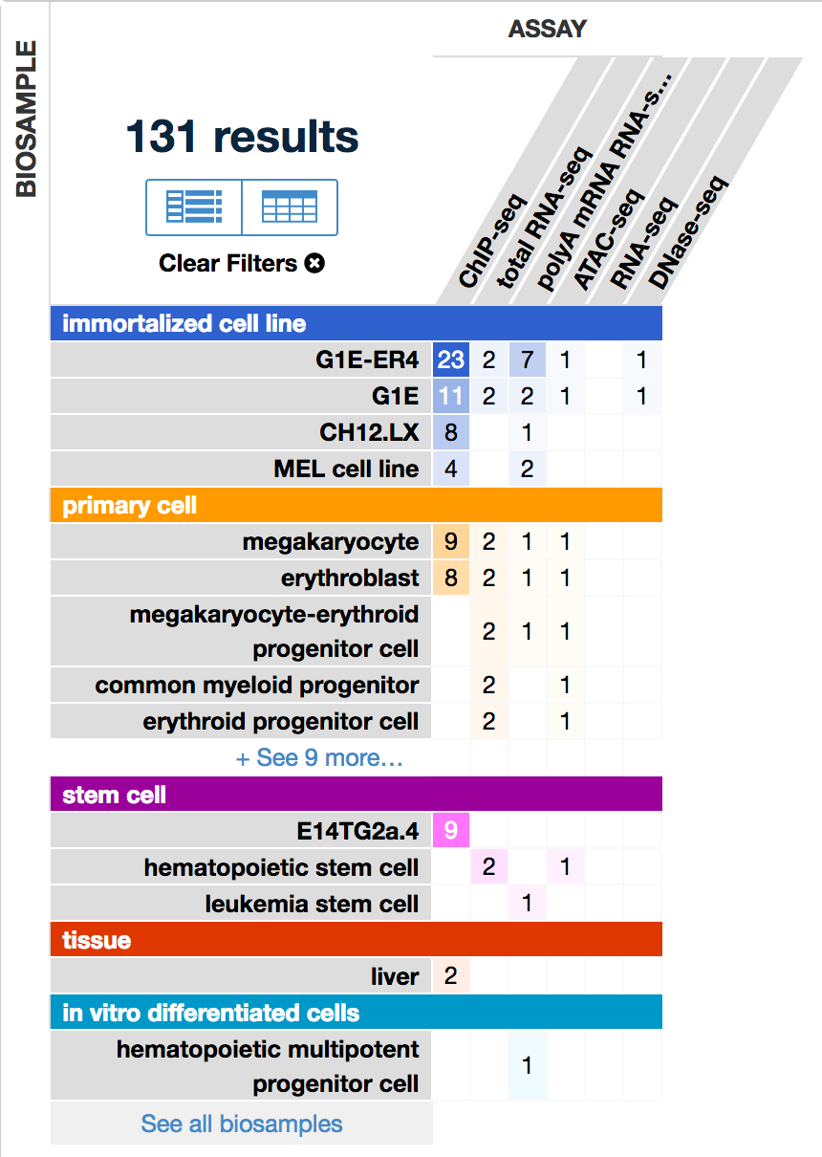
ENCODE: Encyclopedia of DNA Elements
HAIB Production Group
Rick Myers (HudsonAlpha)
Ross Hardison (PSU)
Barbara Wold (Caltech)
Ali Mortazavi (UC Irvine)
Tim Reddy (Duke)
Source: https://www.encodeproject.org/

Slide 3
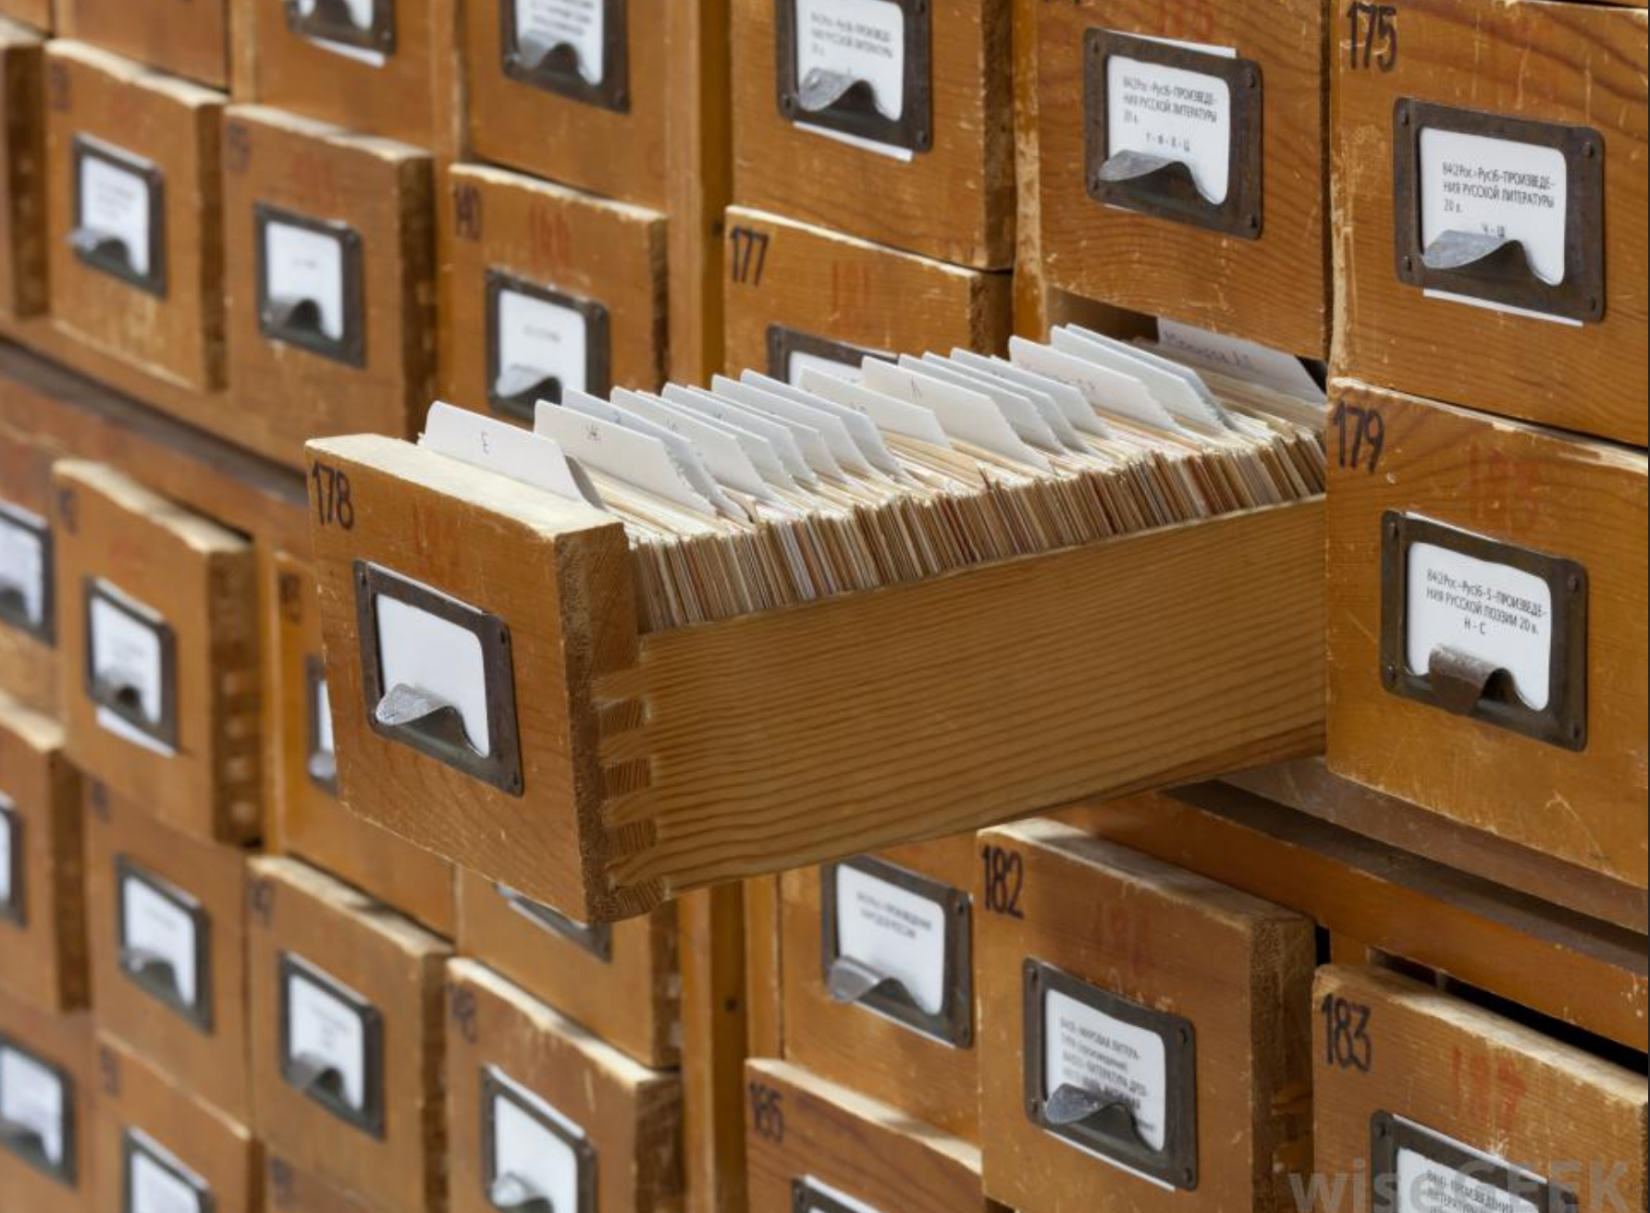
Metadata is not a new concept
Source: http://www.wisegeek.org/what-is-a-card-catalog.htm

Slide 4
Metadata provides information about other data
Descriptive metadata – Describes a resource for purposes of discovery and identification
Structural metadata – Describes how compound objects or data (i.e. databases) are organized and their relationships, versions, etc.
Administrative metadata – Describes how to manage a resource, how it was created and other technical details, etc.

Slide 5
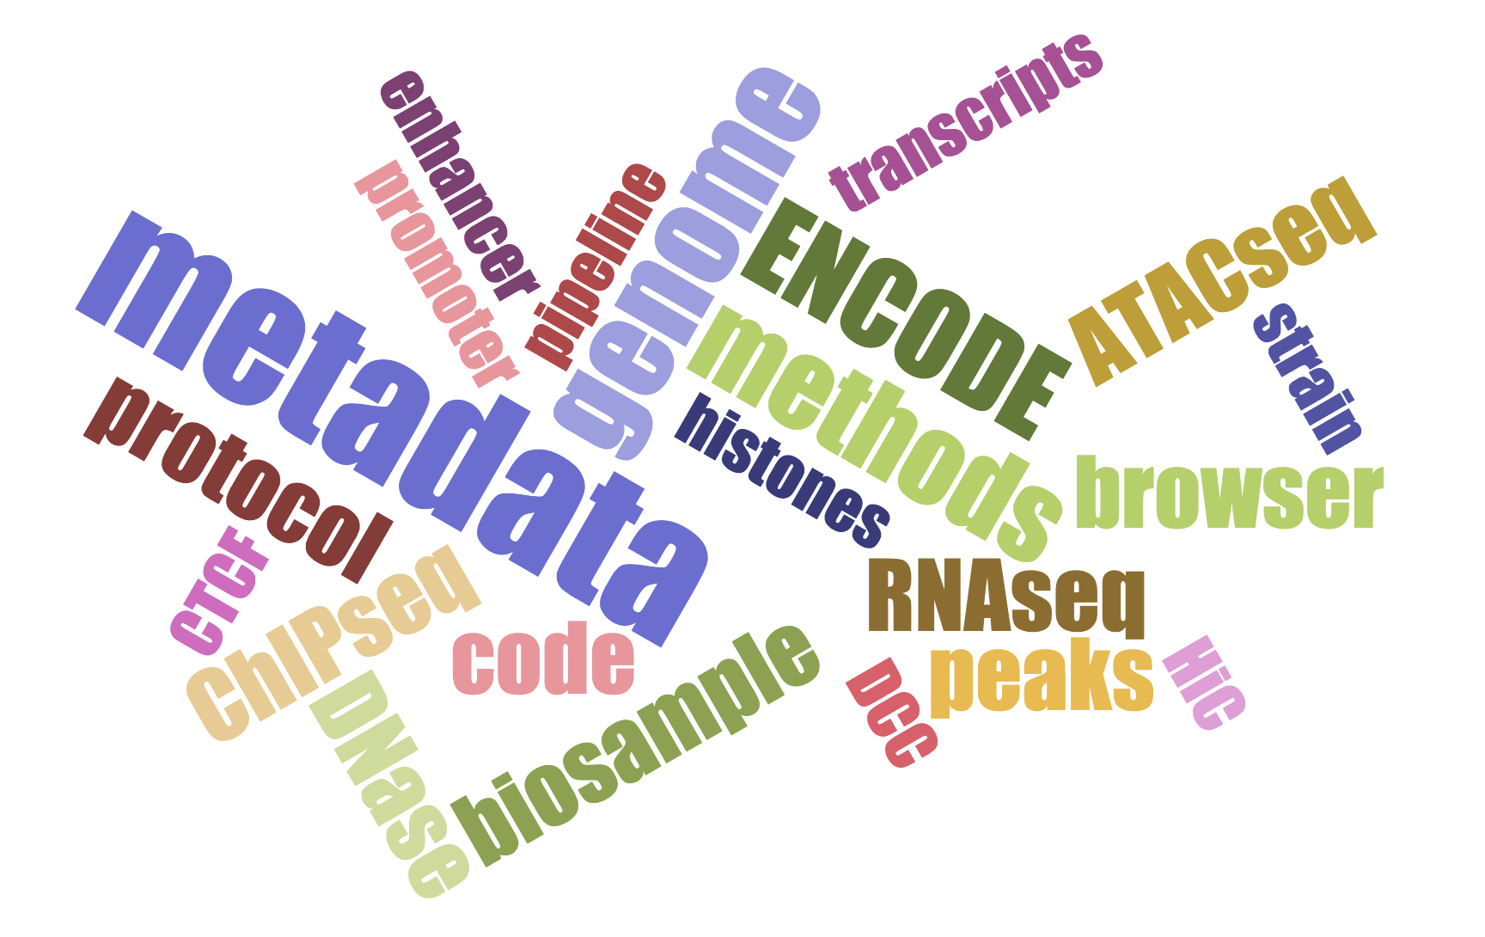
Metadata considerations
Authentication of key biological resources
Accurate and complete lab records
Consistent protocols
Sample tracking
Unique identifiers
Processing pipelines
Controlled vocabulary

Slide 6
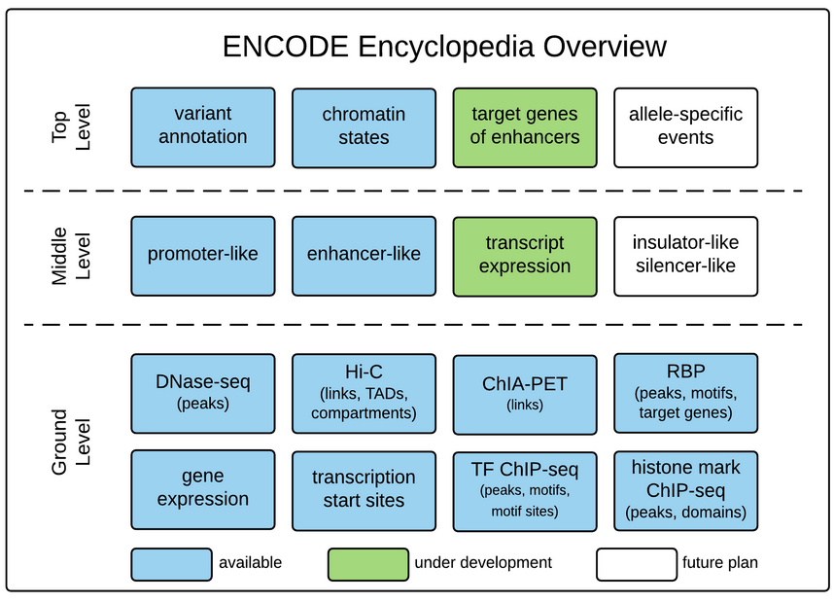
Source: https://www.encodeproject.org/data/annotations/

Slide 7
Each level is dependent on quality of lower levels
Integrative analysis
Genomic features
Biosamples and metadata
Genomic annotations
Raw experimental data
Top level
Middle level
Ground level
Foundation
?

Slide 8
Metadata helps facilitate reproducibility
Integrative analysis
Genomic features
Biosamples
Genomic annotations
Raw experimental data
Top level
Middle level
Ground level
Foundation
Building
blocks

Slide 9
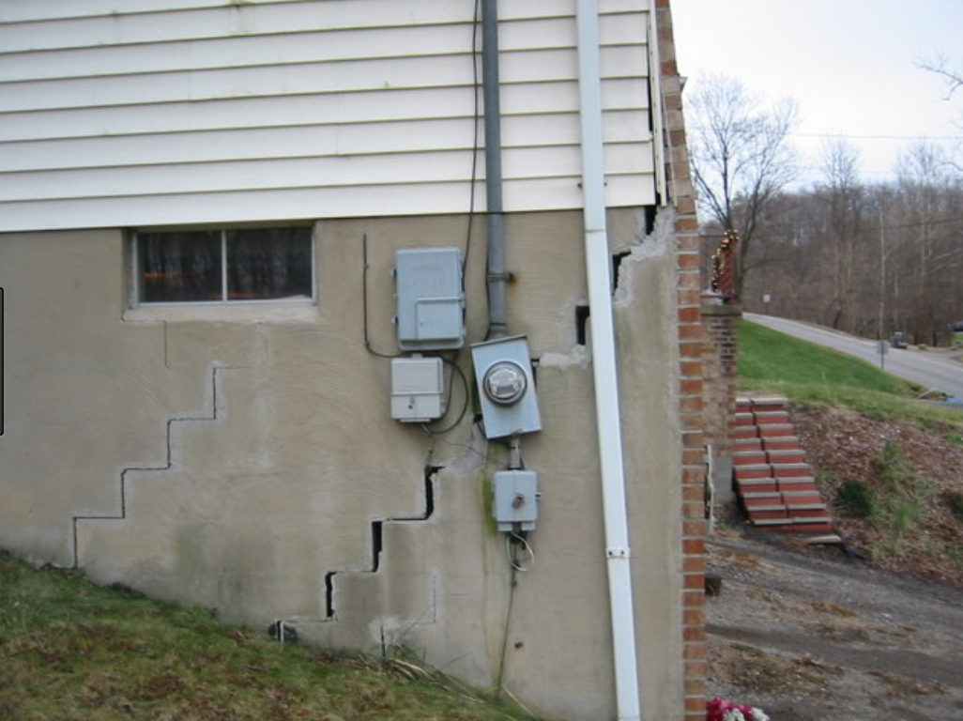
If your foundation is not solid….

Slide 10
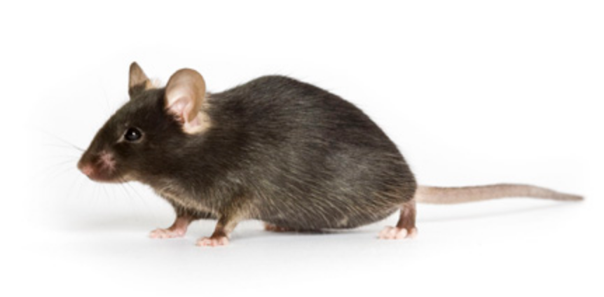
From mouse to machine (learning!)
Yu Zhang

Slide 11
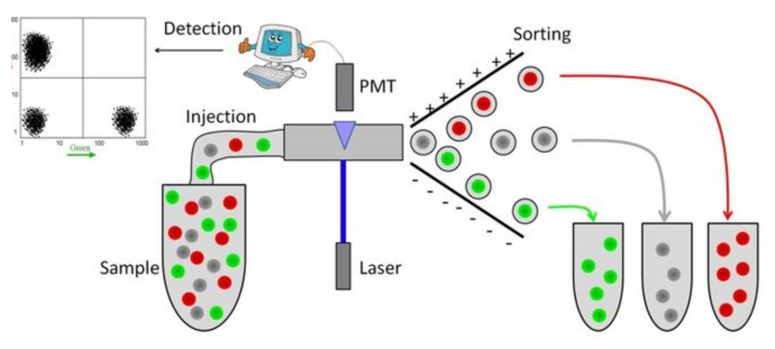
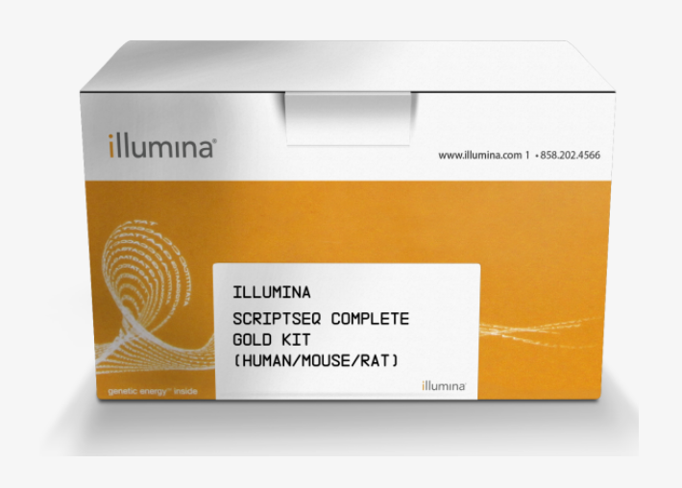
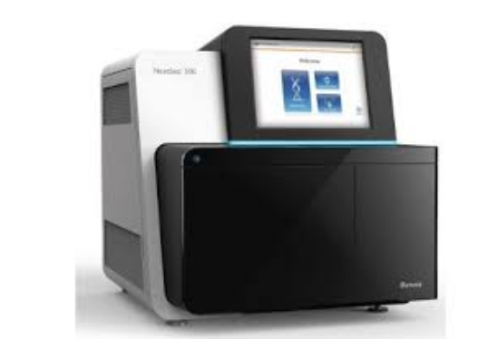
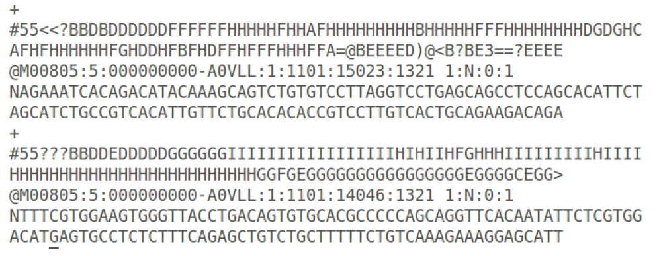
Metadata must be collected at every step
Step
Example
Biosample
Strain, tissue
Sample processing
Antibodies
Library generation
Methods
Sequencing
Platform
Raw data
Q scores
Processed data
Pipeline

Slide 12
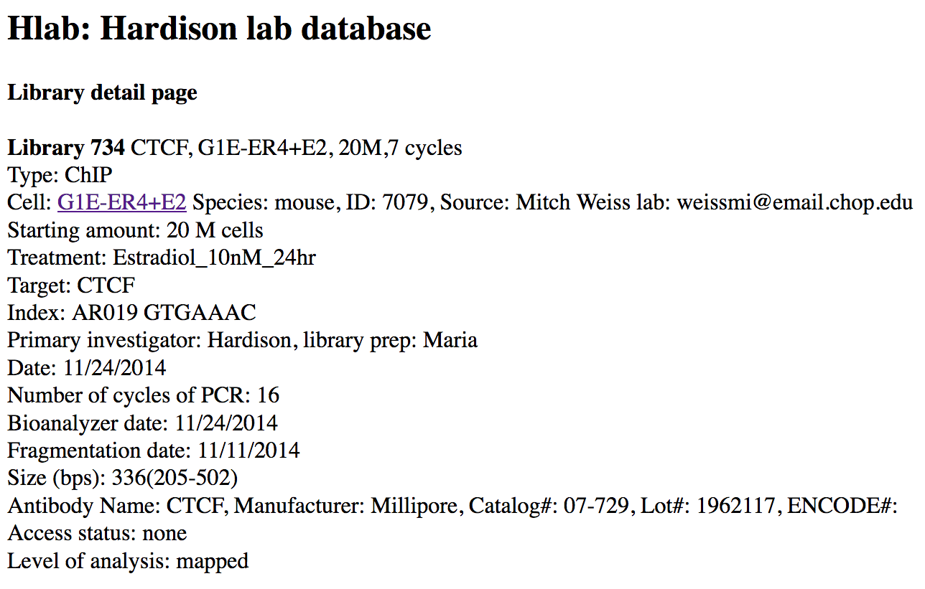
Hardison lab uses an internal database to store metadata
unique identifier
Belinda Giardine

Slide 13
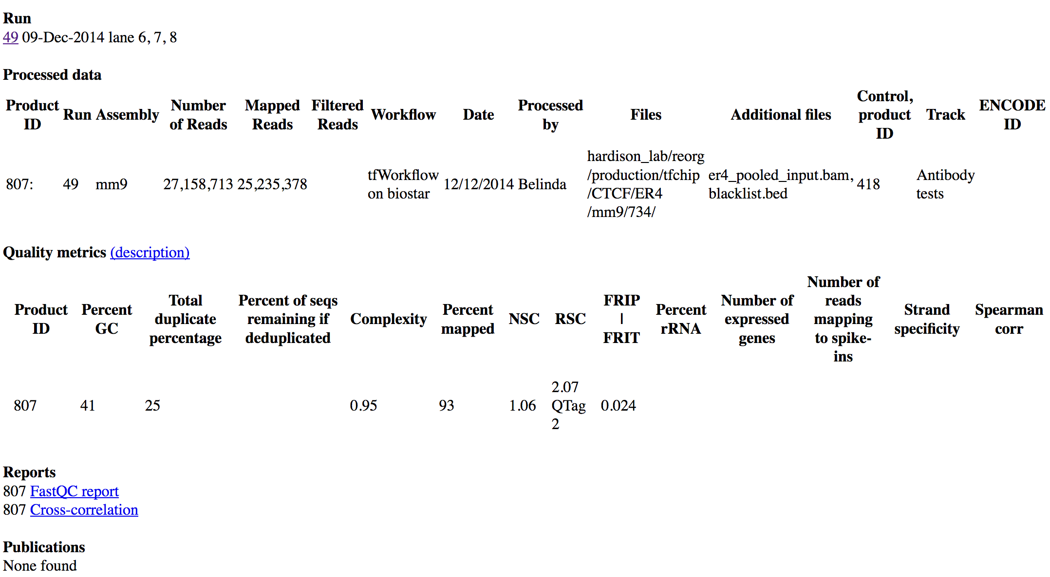
Hardison lab database
Belinda Giardine

Slide 14
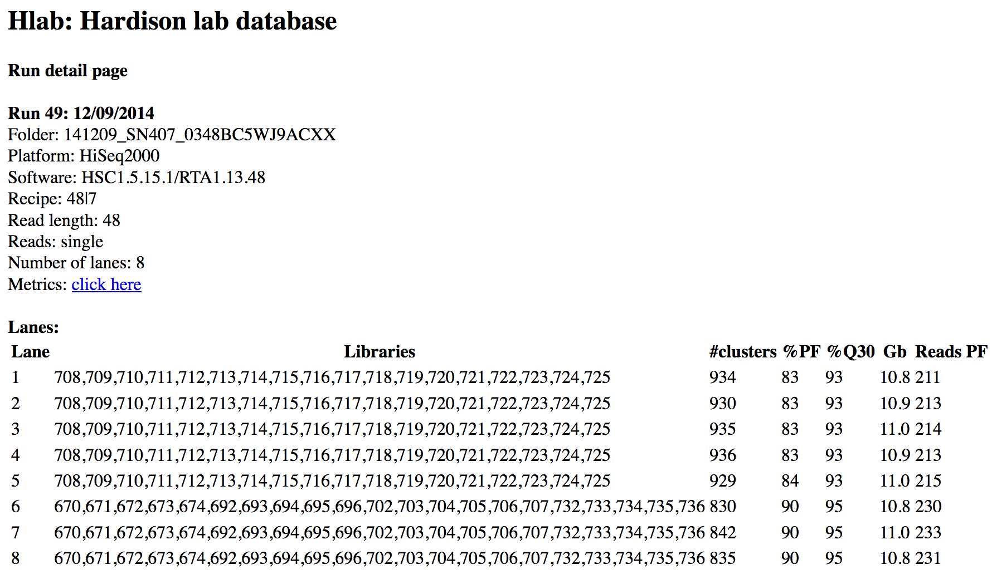
Hardison lab database
Belinda Giardine

Slide 15
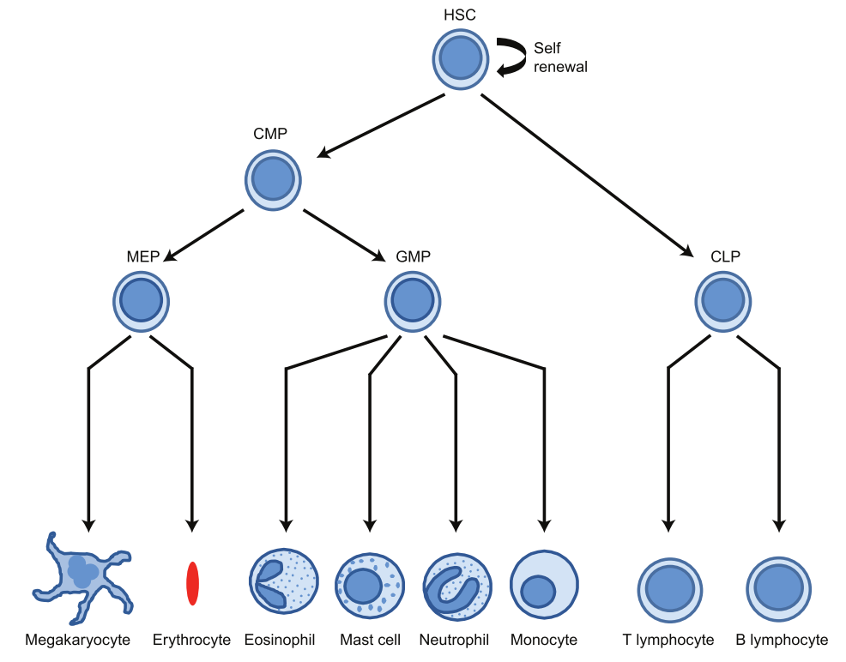

Simplified scheme of hematopoiesis
HSC
HPC7
CMP
MEP
GMP
CLP
G1E
ER4
CFU-Mk
CFU-E
MEG
ERY
EOS
Mast
GRA
MONO
T
B
NK
2 M sec⁻¹

Slide 16
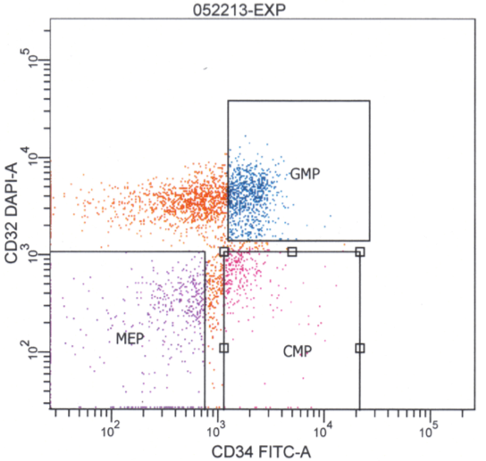
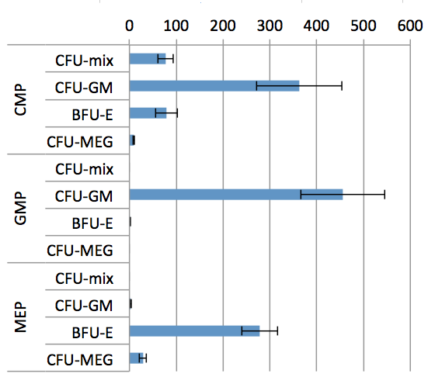
Biosamples for RNA-seq hematopioetic progenitors
Bone marrow (BM)
cells
FACS
Multi-lineage
progenitor cells
HSC CMP GMP MEP
RNA RNA RNA RNA
Bodine lab
Number of colonies

Slide 17
Biosamples for RNA-seq hematopioetic progenitors
= 20 biosamples
Bone marrow (BM)
cells
species
strain
gender
age
source
FACS
Multi-lineage
progenitor cells
HSC CMP GMP MEP
RNA RNA RNA RNA
Bodine lab

Slide 18
Biosamples for RNA-seq hematopioetic progenitors
Bone marrow (BM)
cells
= 1 biosample (pool)
FACS
species
strain
gender
age
Source
# mice
tissue
Multi-lineage
progenitor cells
HSC CMP GMP MEP
RNA RNA RNA RNA
Bodine lab

Slide 19
Biosamples for RNA-seq hematopioetic progenitors
Bone marrow (BM)
cells
cell isolation protocol
sort markers
Ab sources
FACS
= 4 biosamples
Multi-lineage
progenitor cells
HSC CMP GMP MEP
Not everyone uses same sort markers!
RNA RNA RNA RNA
Bodine lab

Slide 20
Biosamples for RNA-seq hematopioetic progenitors
Bone marrow (BM)
cells
FACS
isolation protocol
kit source, catalog
Multi-lineage
progenitor cells
HSC CMP GMP MEP
RNA RNA RNA RNA
= 4 biosamples
Bodine lab

Slide 21
Biosamples for RNA-seq hematopioetic progenitors
Bone marrow (BM)
cells
FACS
What if HSCs are split into two groups for RNA?
Multi-lineage
progenitor cells
HSC CMP GMP MEP
Biological replicate
or
Technical replicate?
RNA RNA
Bodine lab

Slide 22
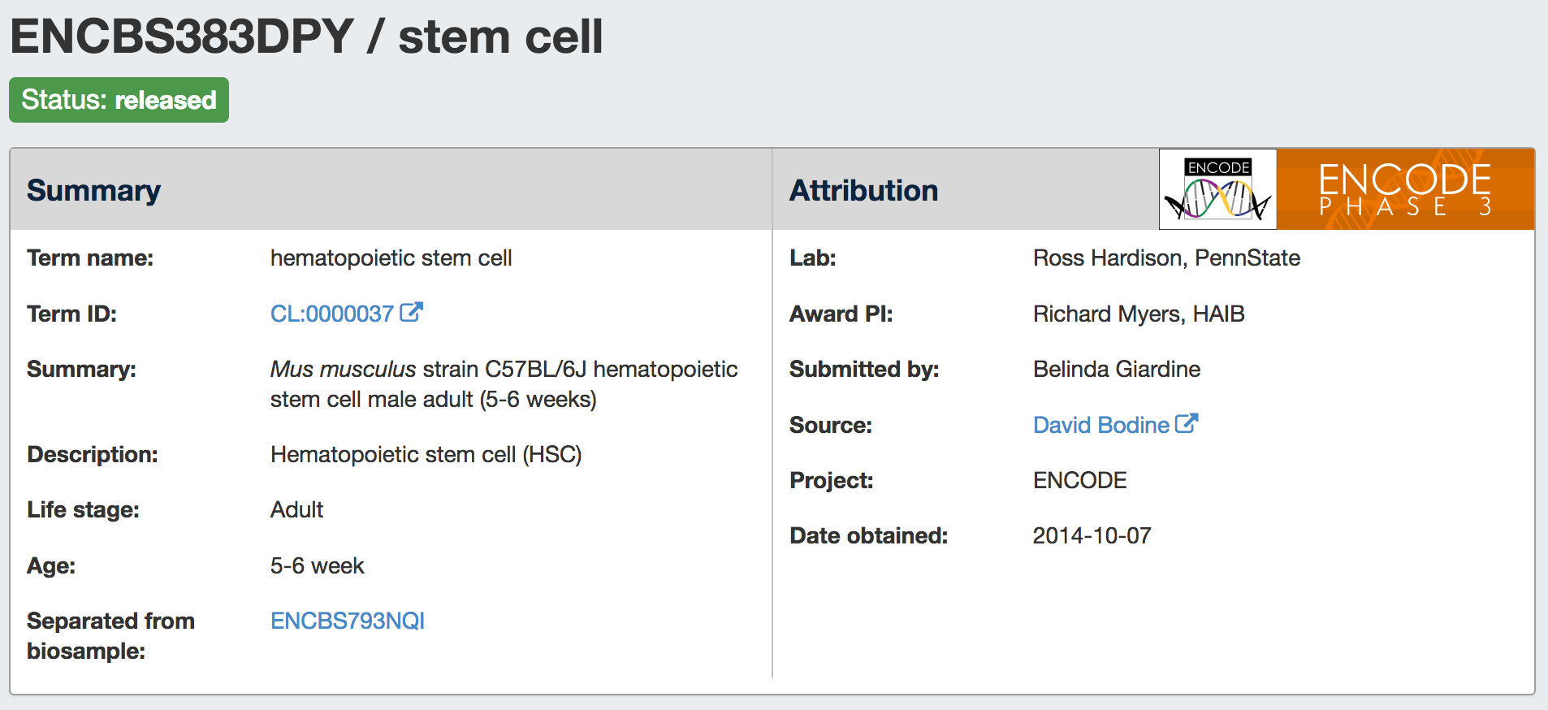
Biosample: Hematopioetic stem cell (HSC)
https://www.encodeproject.org/biosamples/ENCBS383DPY/

Slide 23
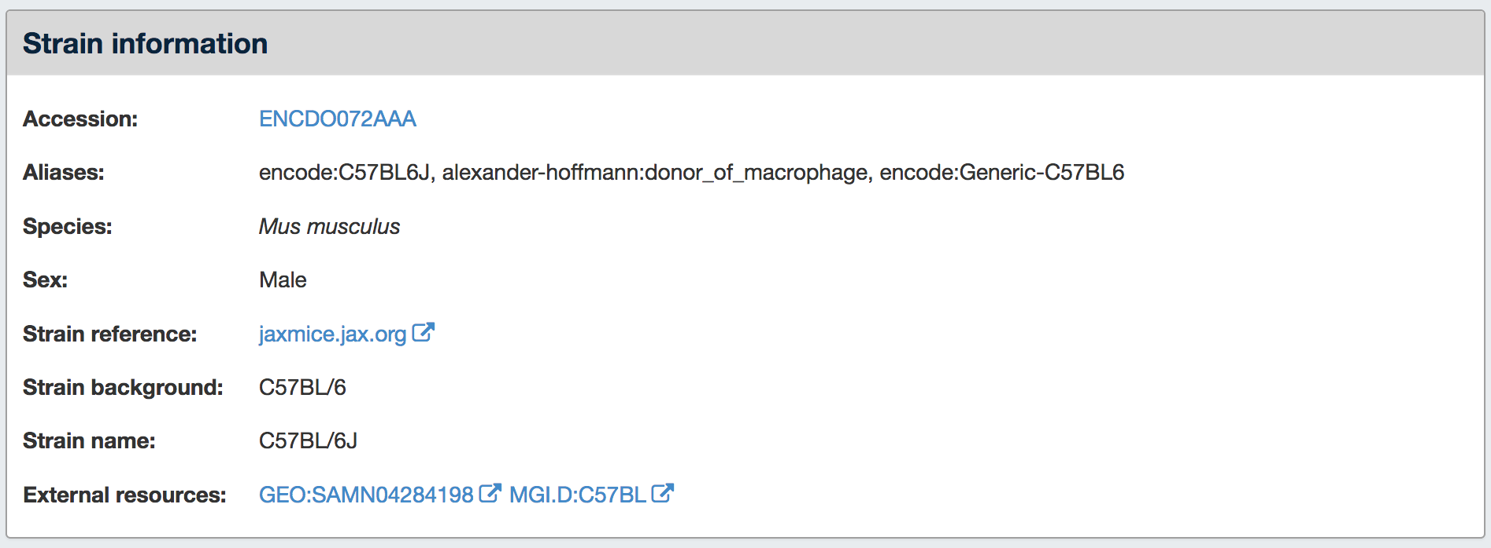
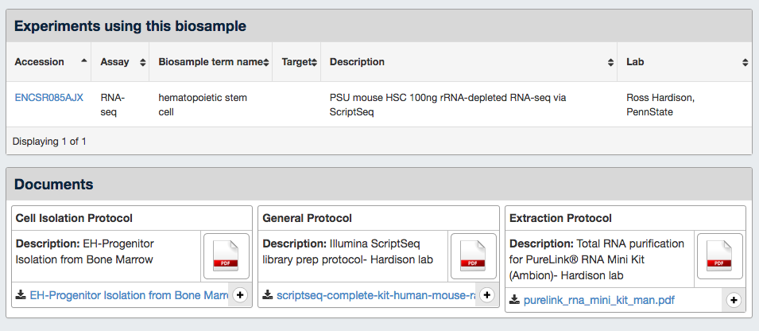

Slide 24
RNA-seq of hematopioetic progenitors
HSC
HPC7
CMP
MEP
GMP
CLP
G1E
ER4
CFU-Mk
CFU-E
MEG
ERY
EOS
Mast
GRA
MONO
T
B
NK
2 M sec⁻¹

Slide 25
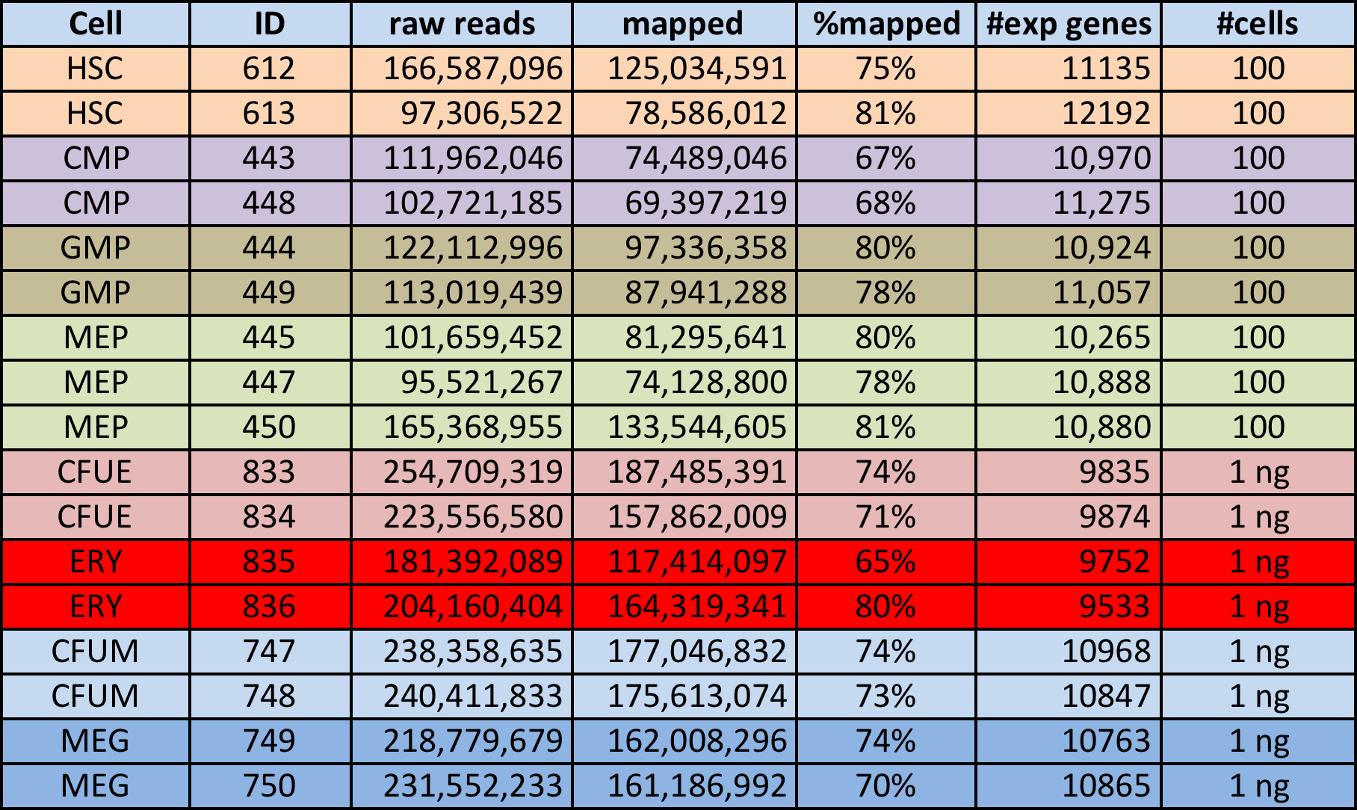
Totalscript RNA-seq data

Slide 26
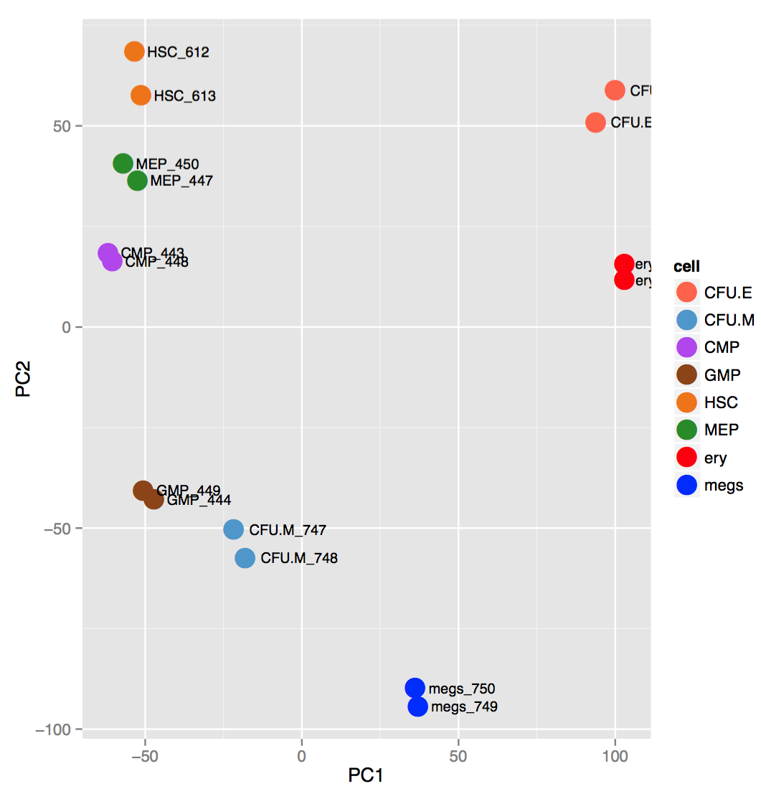
Erythroid cells separate from others in Totalscript
17% variance
26% variance
July 15, 2015

Slide 27
Erythroid cells separate from others in Totalscript
17% variance
100 cells
1 ng
26% variance
July 15, 2015

Slide 28
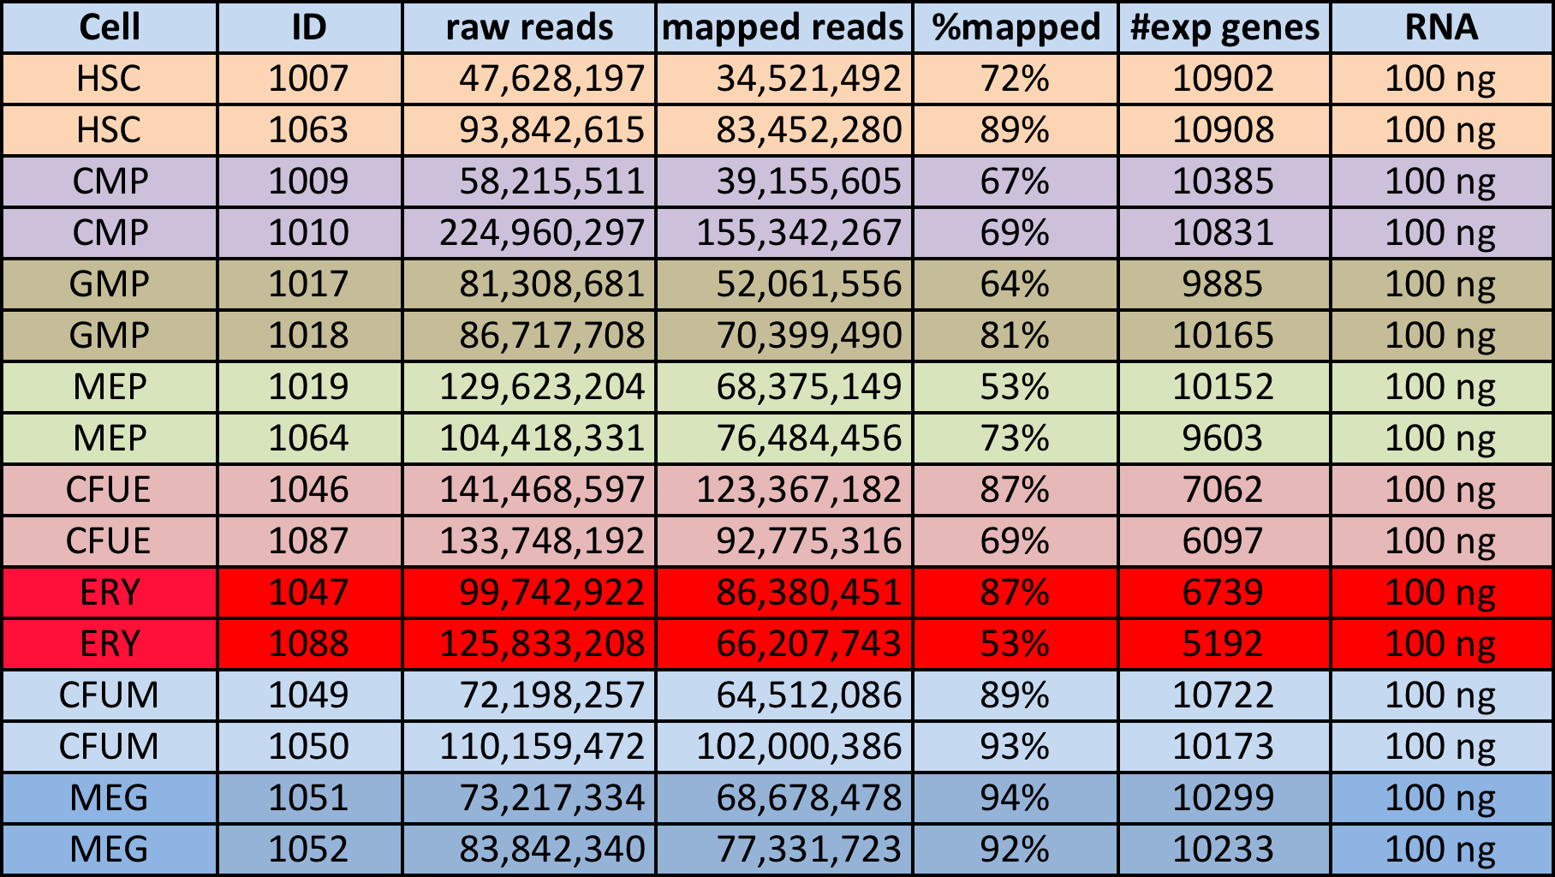
Scriptseq RNA-seq data

Slide 29
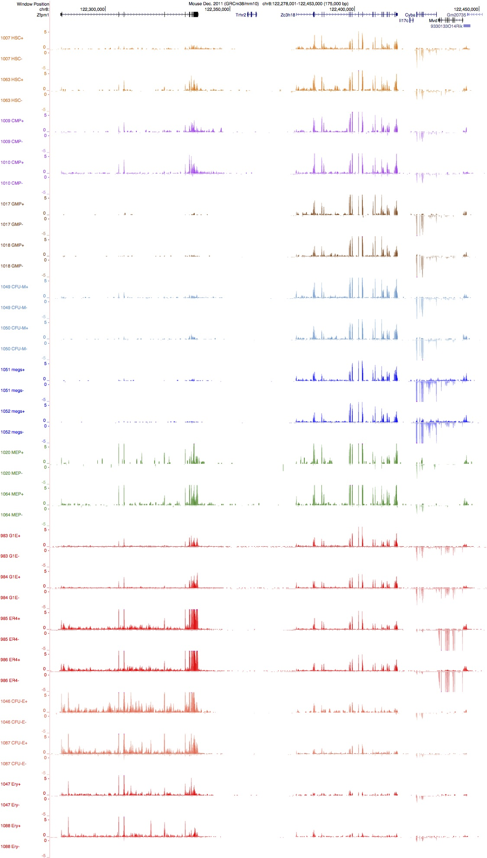
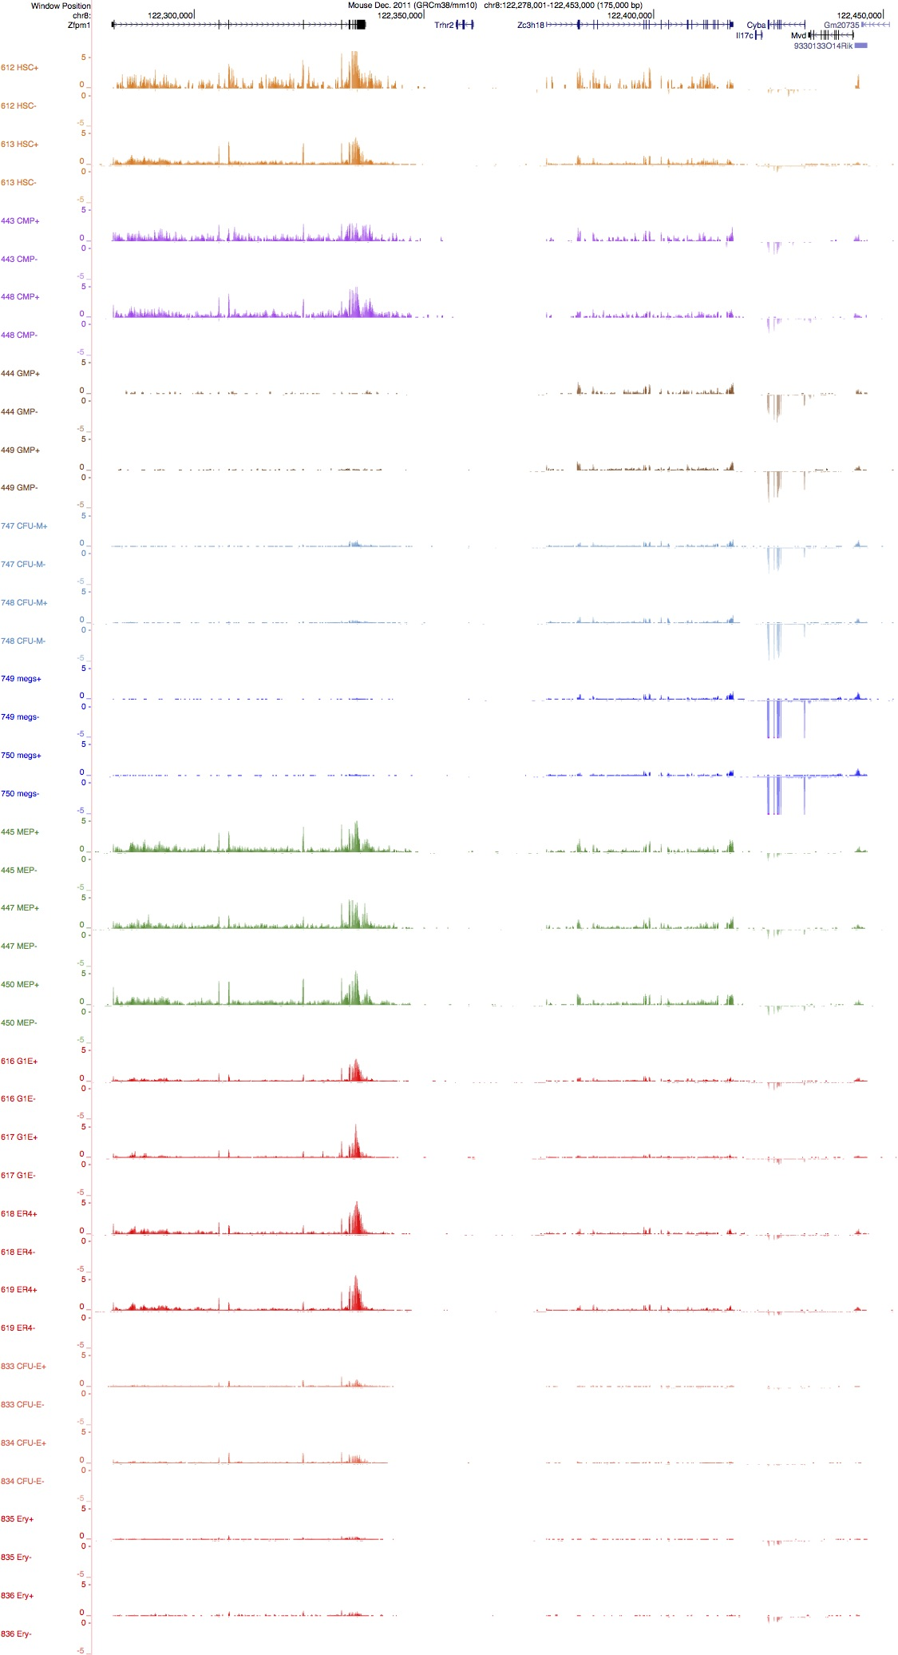
Scriptseq
Totalscript

Slide 30
Scriptseq vs. Totalscript:
Similar relationships between cell types for PC1 vs PC2

Slide 31
Scriptseq vs. Totalscript:
Cells types separate by method PC2 vs PC3

Slide 32
Hierarchical clustering shows similar trends

Slide 33
ENCODE audits alert user to metadata concerns
https://www.encodeproject.org/data-standards/audits/
System of audits or flags provide additional information to research community about quality of the data
Flags may indicate:
- error in experimental metadata,
- data itself does not meet some aspect of the consortium standards
Color of the flags indicate severity of the problem

Slide 34
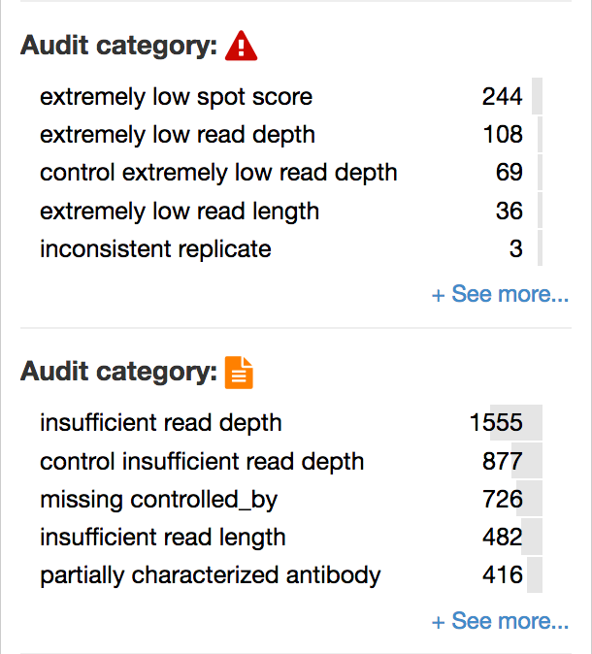
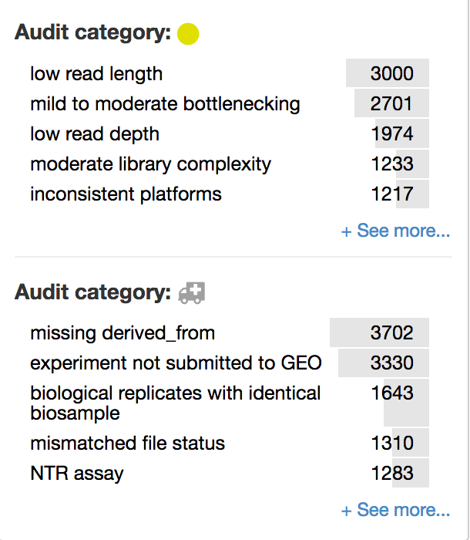
Flags, flags, everywhere!
https://www.encodeproject.org/matrix/?type=Experiment

Slide 35


Acknowledgements
Hardison lab (PSU)
Ross Hardison
Belinda Giardine
Amber Miller
Former lab members
Maria Long
Nergiz Dogan
Weisheng Wu
Christapher Morrisey
Tejaswini Mishra
Yong Cheng
Marta Bryska-Bishop
Swathi Kumar
Bodine lab (NHGRI)
David Bodine
Elisabeth Heuston
Stacie Anderson
Zhang lab (PSU)
Yu Zhang
Lin An
ENCODE3 production group
Rick Myers (HudsonAlpha)
Barbara Wold (Caltech)
Ali Mortazavi (UC Irvine)
Tim Reddy (Duke)

